Slide 1
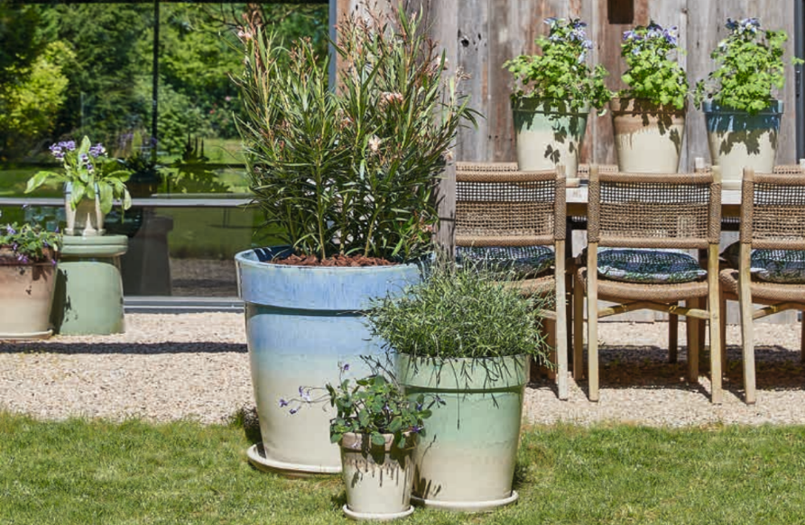

Category Plan
Outdoor Pottery 2025 - 2030

Slide 2

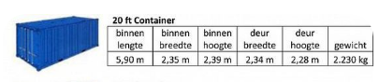
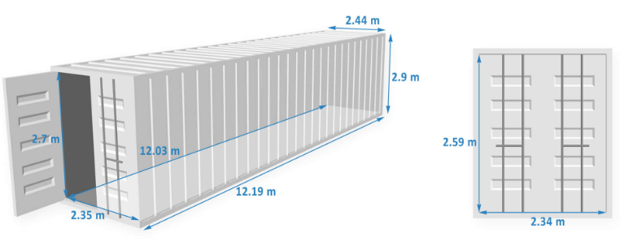
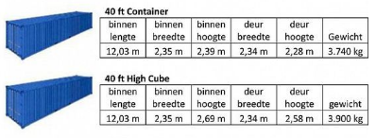
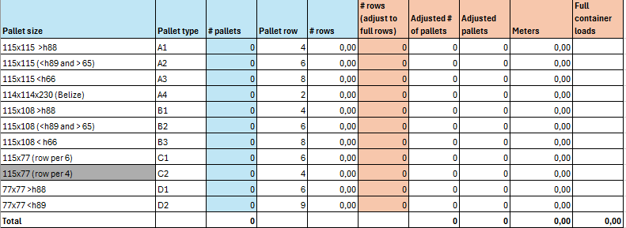
Outdoor Pottery 2025-2030
Container Loading
3 sizes of shipping containers: 20ft; 40ft and 40 High Cube
Overview pallet sizes (in column ‘Pallet row’ you can see how many pallets of this type can fit in a single row in the container. This overview is based on a 40 High Cube container
I use this overview to check all containers
which go via our warehouse (regular orders)

Slide 3
Loading template - objective
Goal is to provide an excel template to sales in which they can fill up a container with outdoor pots for the ‘direct’ container business from supplier to customer in an easy way without necessary check from Purchase department / Product management.
This template must be equipped with following filters / parameters (marked in blue means available in AX):
Supplier -> itemlist including all item information and photos
Type of container (20ft; 40ft; 40 HC)
Inco terms ( FOB, DDP, Exworks, etcetera)
Shipping port
Order qty -> number of pallets / order qty (boxpacking) ->number of outer cartons
Pallet size / outer carton size
Weight
Calculation how many pallets selected / ordered of particular palletsize ; or outercartons / cartonsize
Calculation how many rows / % of container is filled.
Information how many pallets of which pallet sizes / or outercartons/cbm still need to be selected to fill up full rows/container
warning if container full or overfilled.
More requirements, possibilities can be discussed.

